Slide 1
MOAT ACADEMY
WEB APPLICATION DEVELOPMENT TRAINING
Colors, Fonts , External CSS – Day2

Slide 2
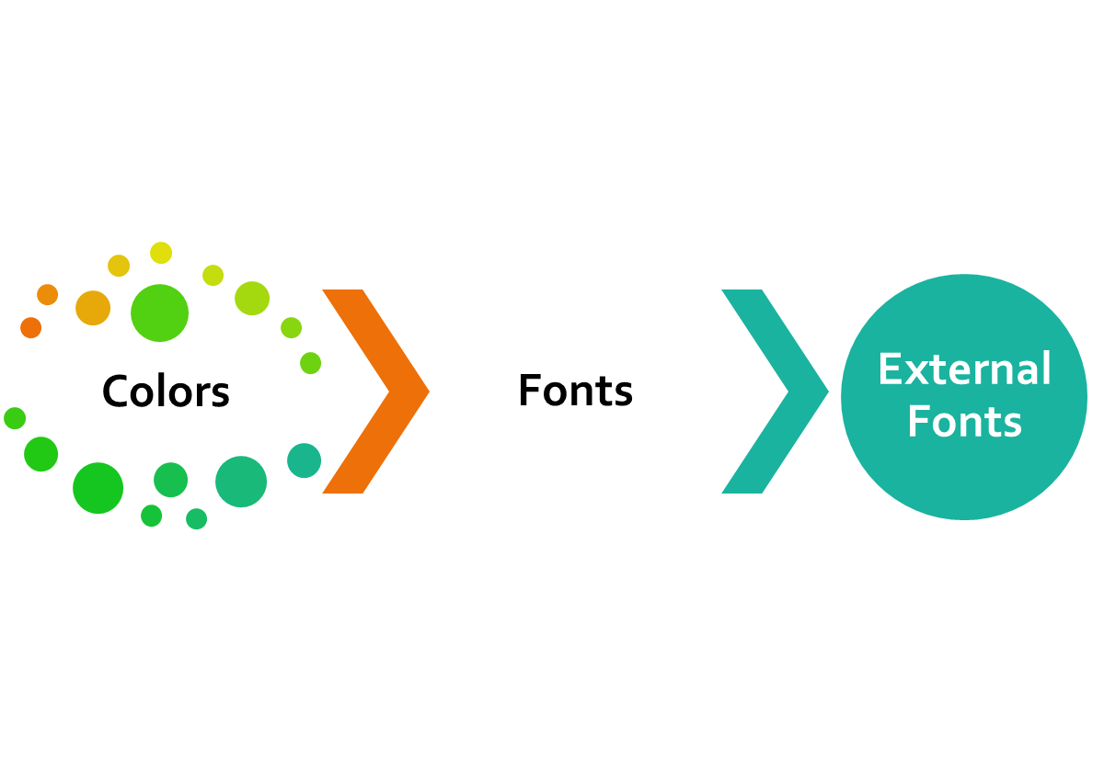
CLASS
OUTLINE

Slide 3
CSS COLORS
Colors are specified using predefined color names, or RGB, HEX, HSL, RGBA, HSLA values.

Slide 4
COLOR NAMES
In HTML, a color can be specified by using a color name:
Tomato, Orange, DodgerBlue, MediumSeaGreen, Gray,SlateBlue, Violet, LightGray
HTML Supports 140 standard color names.

Slide 5
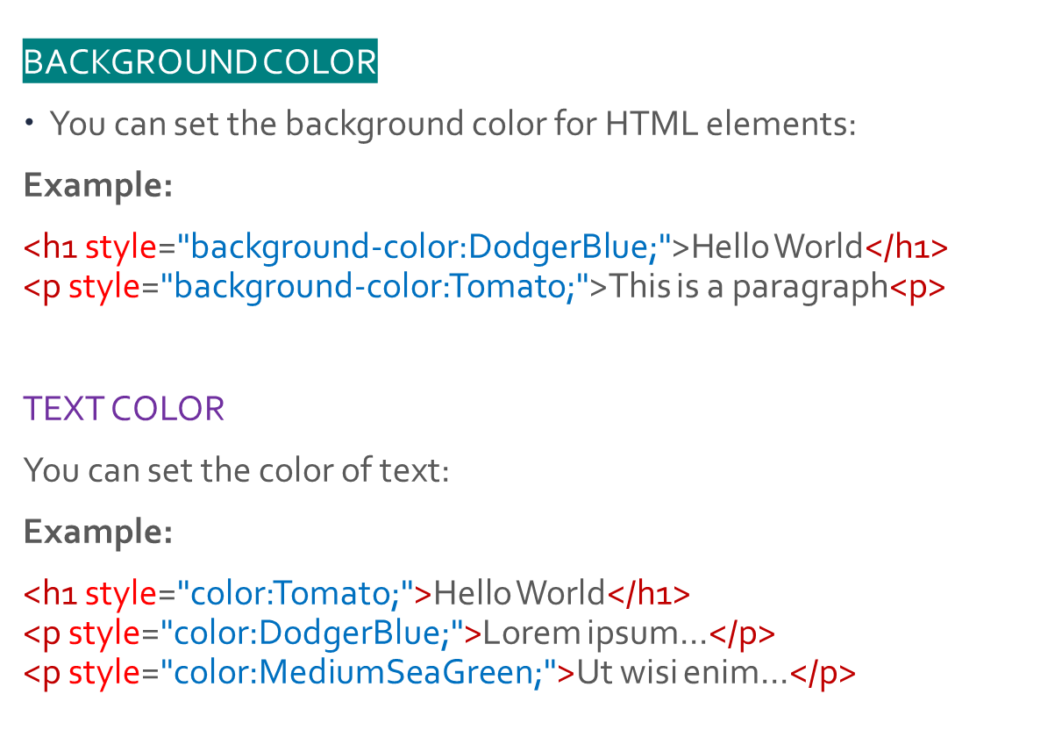
USE CASES

Slide 6
Quiz
Create a HTML page
How would you specify that all paragraph elements <p> on the page be written in red?

Slide 7
USE CASES
BORDER COLOR
You can set the color of borders:
Example:
<h1 style="border:2px solid Tomato;">Hello World</h1>
<h1 style="border:2px solid DodgerBlue;">Hello World</h1>
<h1 style="border:2px solid Violet;">Hello World</h1>

Slide 8
COLOR VALUES
Default font color is Black
In HTML, colors can also be specified using RGB values, HEX values, HSL values, RGBA values, and HSLA values:
Example:
Same as color name "Tomato":
rgb(255, 99, 71)
#ff6347
<h1 style="background-color:rgb(255, 99, 71);">...</h1>
<h1 style="background-color:#ff6347;">...</h1>
Same as color name "Tomato", but 50% transparent:
rgba(255, 99, 71, 0.5)
<h1 style="background-color:rgb(255, 99, 71,0.5);">...</h1>

Slide 9
RGB VALUES
In HTML, a color can be specified as an RGB value, using this formula:
rgb(red, green, blue)
Each parameter (red, green, and blue) defines the intensity of the color between 0 and 255.
Each of the rgb can have between 0 – 255 value any thing outside this range is syntactically wrong
For example, rgb(255, 0, 0) is displayed as red, because red is set to its highest value (255) and the others are set to 0.

Slide 10
QUIZ
As you manipulate the numbers, they give you different shades of the colour
What do you think rgb(255,100,0) will give us? – A colour close to?

Slide 11
RGBA VALUES
RGBA color values are an extension of RGB color values with an alpha channel - which specifies the opacity for a color.
An RGBA color value is specified with:
rgba(red, green, blue, alpha)
The alpha parameter is a number between 0.0 (fully transparent) and 1.0 (not transparent at all):
Example:
rgba(255, 99, 71, 0.5)
<h1 style="background-color:rgb(255, 99, 71,0.5);">...</h1>

Slide 12
HEX VALUES
In HTML, a color can be specified using a hexadecimal value in the form:
#rrggbb or #rgb (if each of rgb are the same)
Where rr (red), gg (green) and bb (blue) are hexadecimal values between 00 and ff (same as decimal 0-255).
For example, #ff0000 is displayed as red, because red is set to its highest value (ff) and the others are set to the lowest value (00).

Slide 13
Do we need trial and errors in choosing colours?
You can use tools such as MS Paints, Corel Draw to get the values
Type color picker on google to get the color chart
You can also use certain browser plugins like Mozilla Firefox Color Picker to get the codes
A good sense of color mix is important for a designer
Useful : https://coolors.co/app

Slide 14
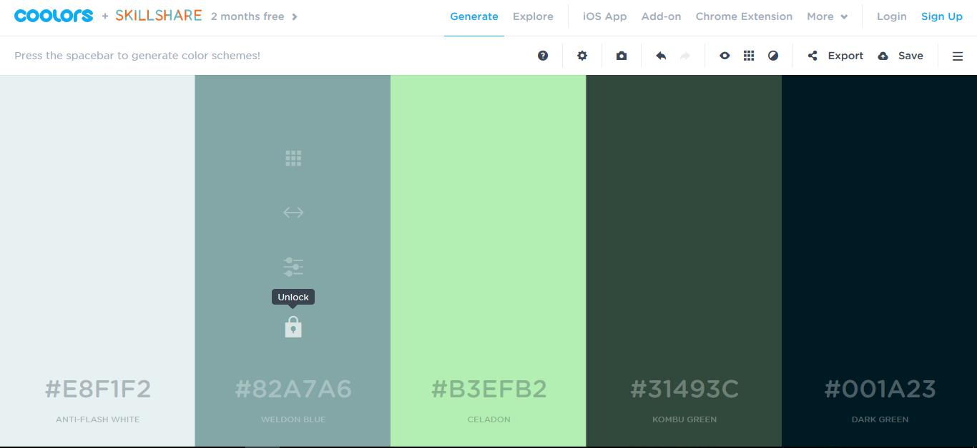
Getting colour combination from coolors.co
Notes:
Note on https://coolors.co/app:
Keep pressing the space bar for different color mix
There are a range of options when you hover on the columns, eg:
You can lock a color in a particular column by clicking on the padlock icon so that the app can generate other colors that can be combined with the one you locked
You can edit any of the color value if you have your own custom design (say a customer already tells you the shade he wants)
When you are done, you can export it for your reference

Slide 15
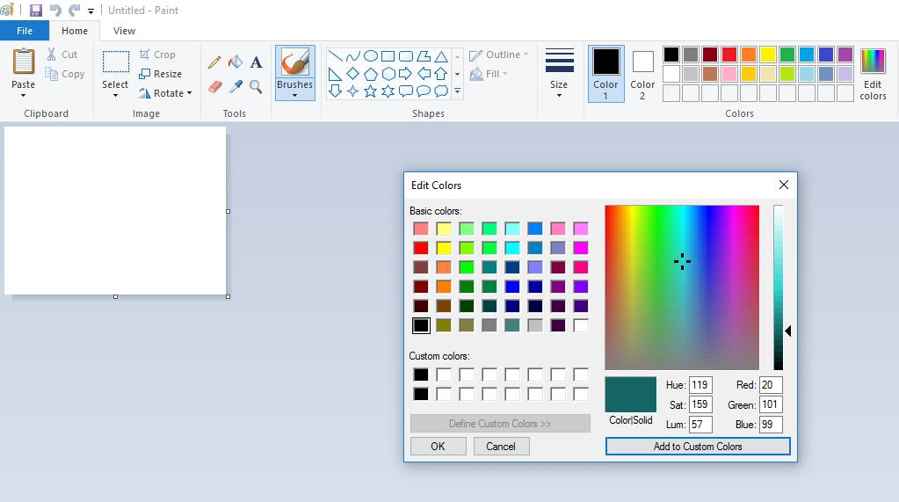
rgb value from MS Paint
Notes:
Create a new document
Click on the”Edit Color” at the top right to dispay the color pallete, as you select diferent shades, the corresponding rgb is generated in the box as shown

Slide 16
CSS FONTS
The CSS font properties define the font family, boldness, size, and the style of a text.

Slide 17
CSS FONT FAMILIES
In CSS, there are two types of font family names:
generic family - a group of font families with a similar look (like "Serif" or "Monospace")
font family - a specific font family (like "Times New Roman" or "Arial")
Generic family | Font family | Description
Serif | Times New Roman Georgia | Serif fonts have small lines at the ends on some characters
Sans-serif | Arial Verdana | "Sans" means without - these fonts do not have the lines at the ends of characters
Monospace | Courier New Lucida Console | All monospace characters have the same width
Note: On computer screens, sans-serif fonts are considered easier to read than serif fonts.

Slide 18
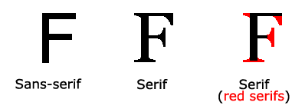
Generic Font Family Explained
Notes:
San serif – those without curves
Serif – those with curves

Slide 19
FONT-FAMILY
The font family of a text is set with the font-family property.
The font-family property should hold several font names as a "fallback" system. If the browser does not support the first font, it tries the next font, and so on.
Start with the font you want, and end with a generic family, to let the browser pick a similar font in the generic family, if no other fonts are available.
Note: If the name of a font family is more than one word, it must be in quotation marks, like: "Times New Roman".
More than one font family is specified in a comma-separated list:
Example:
p {
font-family: "Times New Roman", Times, serif;
}

Slide 20
TIPS
It is usually a best practise to end the font-family specification / list with the generic name. eg
font-family: arial, corbel, sans-serif
In the above, you are telling the browser “I want to use arial, but if arial is not available on this computer.. Use corbel, if both are not available… just use any font that belongs to the family of sans-serif”
Remember sans-serif is no curves, so also arial and corbel.

Slide 21
QUIZ*: What is wrong with this specification?
Font-family: “Times New Romans”, Times, sans-serif;
Notes:
Answer, Times New Roman and Times are both serif, yet the user is saying if there is no Times New Roman, use any one of the family no-curve! Whereas Times News Roman is a serif
It means that the website will look so much different when checked on two systems; one with times news roman, the other when there is no times new romans

Slide 22
FONT-STYLE
The font-style property is mostly used to specify italic text.
This property has three values:
normal - The text is shown normally
italic - The text is shown in italics
oblique - The text is "leaning" (oblique is very similar to italic, but less supported)
Example:
p {
font-style: normal;
}
p {
font-style: italic;
}
p {
font-style: oblique;
}

Slide 23
FONT-SIZE
The font-size property sets the size of the text.
Being able to manage the text size is important in web design. However, you should not use font size adjustments to make paragraphs look like headings, or headings look like paragraphs.
Always use the proper HTML tags, like <h1> - <h6> for headings and <p> for paragraphs.
The font-size value can be an absolute, or relative size.
Absolute size:
Sets the text to a specified size
Does not allow a user to change the text size in all browsers (bad for accessibility reasons)
Absolute size is useful when the physical size of the output is known
Relative size:
Sets the size relative to surrounding elements
Allows a user to change the text size in browsers
Note: If you do not specify a font size, the default size for normal text, like paragraphs, is 16px (16px=1em).

Slide 24
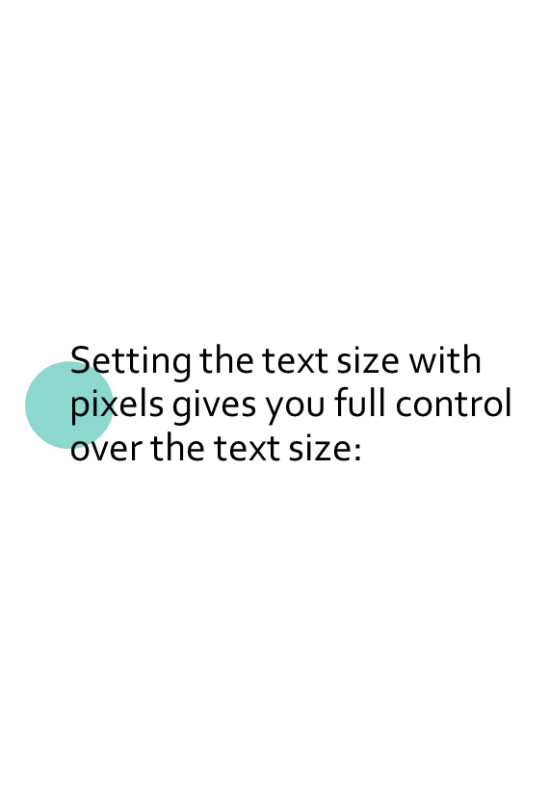
FONT-SIZE WITH PX
h1 {
font-size: 40px;
}
h2 {
font-size: 30px;
}
p {
font-size: 14px;
}
Tip: If you use pixels, you can still use the zoom tool to resize the entire page.

Slide 25
FONT-SIZE WITH EM
To allow users to resize the text (in the browser menu), many developers use em instead of pixels.
The em size unit is recommended by the W3C.
1em is equal to the current font size. The default text size in browsers is 16px. So, the default size of 1em is 16px.
The size can be calculated from pixels to em using this formula: pixels/16=em
h1 {
font-size: 2.5em; /* 40px/16=2.5em */
}
h2 {
font-size: 1.875em; /* 30px/16=1.875em */
}
p {
font-size: 0.875em; /* 14px/16=0.875em */
}

Slide 26
RESPONSIVE FONT-SIZE
The text size can be set with a vw unit, which means the "viewport width".
<h1 style="font-size:10vw">Hello World</h1>
Viewport is the browser window size. 1vw = 1% of viewport width. If the viewport is 50cm wide, 1vw is 0.5cm.

Slide 27
FONT-WEIGHT
The font-weight property specifies the weight of a font:
Syntax:
font-weight: normal|bold|bolder|lighter|number|initial|inherit;
Example:
p.normal {
font-weight: normal;
}
p.thick {
font-weight: bold;
}

Slide 28
EXERCISE
Set the font family for the page to "Courier New", and the font family for <h1> to "Verdana".
Show <p> elements as "italic" text.
Set the font size for the page to "20px", and the font size for <h1> to "3em“
Show <p> elements as "bold" text.
With the font property: Set the <p> to "italic", "20px" and "Verdana".
<!DOCTYPE html>
<html>
<head>
<style>
</style>
</head>
<body>
<h1>This is a Heading</h1>
<p>This is a paragraph.</p>
<p>This is another paragraph.</p>
</body>
</html>

Slide 29
Other CSS Font Properties
text-transform ( uppercase, lowercase, capitalize)
text-decoration (none to remove underline)

Slide 30
EXTERNAL CSS
External style sheets are created in separate documents with a .css extension.
An external style sheet is simply a listing of CSS rules. It cannot contain HTML tags.
The <link> tag, which goes in the head of an HTML page, is used to link to an external style sheet.
There is no limit to the number of external style sheets a single HTML page can use.
Syntax:
<link href=‘filelocation’ rel=‘stylesheet’ type=‘text/css’>
Example
<link href=‘style.css’ rel=‘stylesheet’ type=‘text/css’>

Slide 31
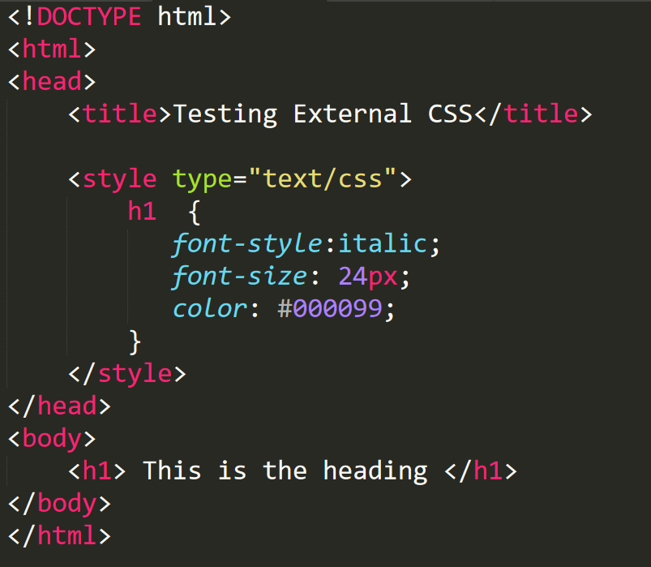
QUIZ: Convert the following to an external css

Slide 32
FONTS FROM EXTERNAL SOURCES
Making the web more beautiful through great typography

Slide 33
Mixing fonts
Your website fonts should be consistent when checked on various devices , you must be careful with the combination of font –family that you use.
Combining too many font types is not recommended
https://fontpair.co/ helps you in pairing fonts.

Slide 34
Using Custom Fonts
To be regarded as web-safe, a font must be common to most browsers. Remember, if a site visitor does not have the specified font, the browser selects an alternative.
The following fonts are considered universal:
  Arial
  Courier New
  Georgia
  Times New Roman
  Verdana
CSS allows you to specify custom fonts which may not even be available on the users’ local computer

Slide 35
GOOGLE FONTS
Google Fonts launched in 2010, quickly becoming the Internet’s largest, free, open-source selection of fonts. All Google Fonts are free for commercial and personal use. The Google Fonts website makes it easy for anyone to quickly select and utilize different fonts for their own design needs.
https://fonts.google.com/
To use Google Fonts, (See next slides)
Embed in HTML
<link href="https://fonts.googleapis.com/css?family=Lato" rel=“stylesheet" >
Specify in CSS
font-family: Lato, sans-serif;

Slide 36
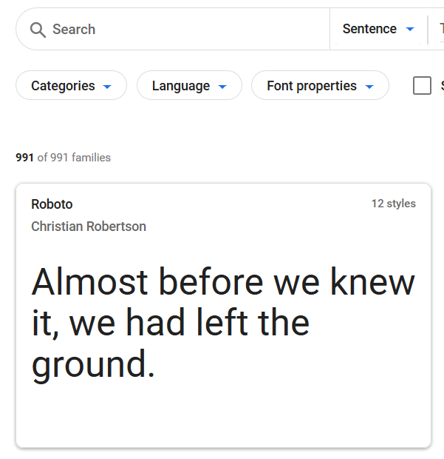
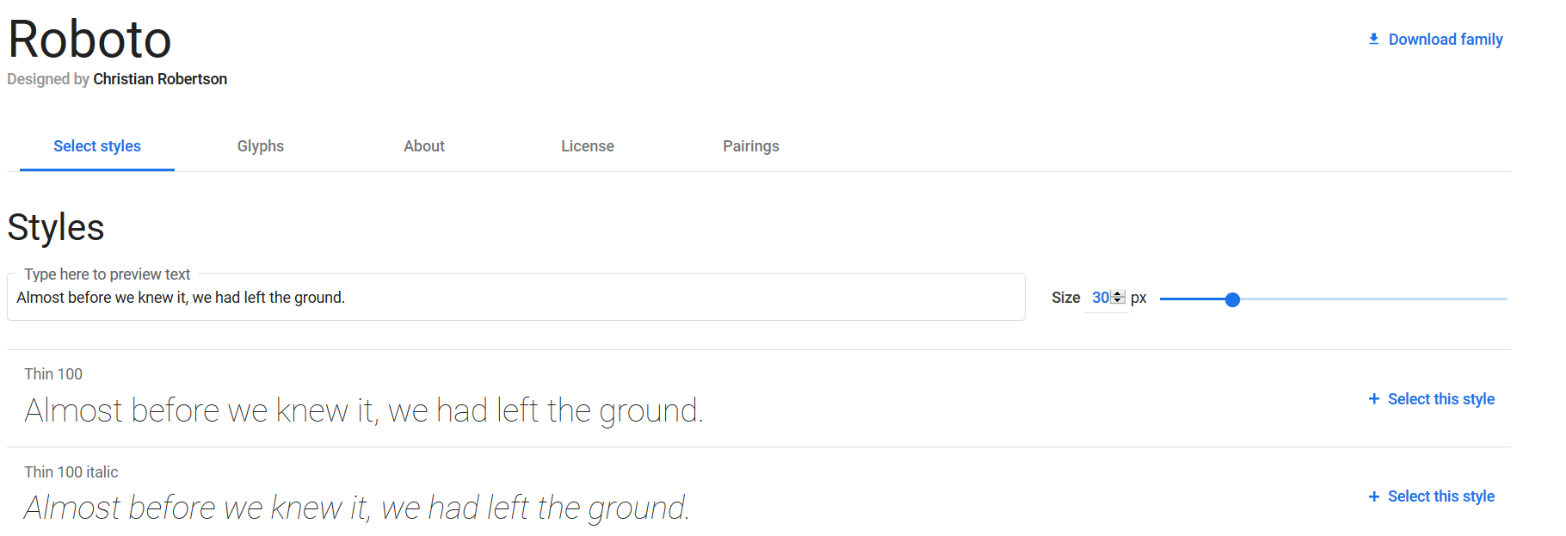
Steps in using Google Fonts
1. Search for a particular font or click on a font of interest
2. it will list all the styles under the font

Slide 37
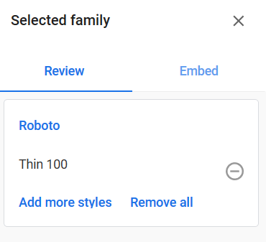

Steps in using Google Fonts
3. click on the link beside the font (Select this style)
4.Do this for as many styles you want to select. The link will turn to ‘remove this style’
5. Your selection(s) will show in the sidebar on the right
6 click on the link ‘Embed’ to copy the embed code

Slide 38
CUSTOM WEB FONTS
Web fonts allow Web designers to use fonts that are not installed on the user's computer.
When you have found/bought, downloaded the font you wish to use, just include the font file on your web server, and it will be automatically downloaded to the user ‘s browser when needed.
Your "own" fonts are defined within the CSS @font-face rule.
Font Formats:
TTF (TrueType Format – Most common for Operating systems)
OTF (OpenType Format)
WOFF (Web Open Font Format – recommended for web pages)
WOFF 2.0
SVG, EOT
TTF/OTF - TrueType and OpenType font support is compatible with Chrome browser 4 to 67
You can generate web-safe fonts using the online tool: https://www.fontsquirrel.com/tools/webfont-generator

Slide 39
@font-face RULE
@font-face {
font-family: myFirstFont;
src: url(sansation_light.woff) format('woff'),
url(sansation_light.ttf) format('truetype'),
url(sansation_light.svg) format('svg’);
}
p {
font-family: myFirstFont;
}
Example 2
@font-face {
font-family: myBoldFont;
src: url(sansation_bold.woff);
}
In the @font-face rule; first define a name for the font (e.g. myCustomFont) and then point to the font file.
To use the font for an HTML element, refer to the name of the font (myCustomFont) through the font-family property:
To use a different font-style, you must add another @font-face rule containing descriptors for the font style:

Slide 40
EXERCISE
<!DOCTYPE html>
<html>
<head>
<style>
body {
font-family: sansation;
}
</style>
</head>
<body>
<h1>This is a Heading</h1>
<p>This is a paragraph.</p>
<p>This is another paragraph.</p>
</body>
</html>
Add a web font with the name "sansation" and the URL "sansation_light.woff".
Add another @font-face rule for bold characters of the "sansation" font. Use the URL "sansation_bold.woff".

Slide 41
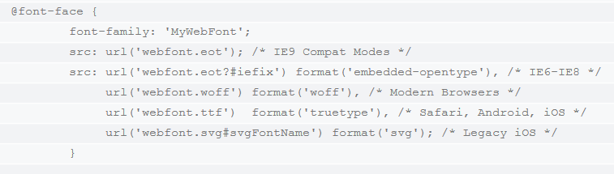
CUSTOM WEB FONTS
Webfonts are supported by all major browser platforms but not all in the same way. There are currently four different font formats that must be included in order to target all browsers. This includes TTF, WOFF, EOT and SVG.
Notes:
@font-face { font-family: 'MyWebFont'; src: url('webfont.eot'); /* IE9 Compat Modes */ src: url('webfont.eot?#iefix') format('embedded-opentype'), /* IE6-IE8 */ url('webfont.woff') format('woff'), /* Modern Browsers */ url('webfont.ttf') format('truetype'), /* Safari, Android, iOS */ url('webfont.svg#svgFontName') format('svg'); /* Legacy iOS */ }

Slide 42

WELDONE GUYS!
Everything is Achievable

